Slide 1


Slide 2



XML Introduction

Slide 3

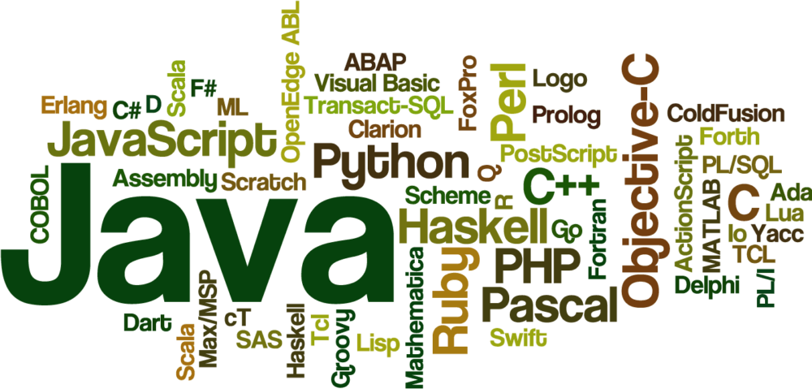


Slide 4
XML
Xml (eXtensible Markup Language) is a mark up language.
XML is not a replacement for HTML.
XML is designed to be self-descriptive.
XML is designed to carry data, not to display data.
XML tags are not predefined. You must define your own tags.
XML is platform independent and language independent.

Slide 5
ADVANTAGES:
Technology agnostic − Being plain text, XML is technology independent. It can be used by any technology for data storage and data transfer purpose.
Human readable − XML uses simple text format. It is human readable and understandable.
Extensible − In XML, custom tags can be created and used very easily.
Allow Validation − Using XSD, DTD and XML structures can be validated easily

Slide 6
EXAMPLE:
<?xml version = "1.0"?> <Class> <Name>First</Name> <Sections> <Section> <Name>A</Name> <Students> <Student>Rohan</Student> <Student>Mohan</Student> <Student>Sohan</Student> <Student>Lalit</Student> <Student>Vinay</Student> </Students> </Section>

Slide 7
XML PARSER
XML Parser provides a way to access or modify data in an XML document.
Java provides multiple options to parse XML documents
StAX Parser − Parses an XML document in a similar fashion to SAX parser but in a more efficient way.
XPath Parser − Parses an XML document based on expression and is used extensively in conjunction with XSLT.
DOM4J Parser − A java library to parse XML, XPath, and XSLT using Java Collections Framework. It provides support for DOM, SAX, and JAXP.

Slide 8
Java DOM Parser
The Document Object Model (DOM) is an official recommendation of the World Wide Web Consortium (W3C).
It defines an interface that enables programs to access and update the style, structure, and contents of XML documents. XML parsers that support DOM implement this interface.

Slide 9
DOM interfaces
Node − The base datatype of the DOM.
Element − The vast majority of the objects you'll deal with are Elements.
Attr − Represents an attribute of an element.
Text − The actual content of an Element or Attr.
Document − Represents the entire XML document. A Document object is often referred to as a DOM tree.

Slide 10
Common DOM methods
Document.getDocumentElement() − Returns the root element of the document.
Node.getFirstChild() − Returns the first child of a given Node.
Node.getLastChild() − Returns the last child of a given Node.
Node.getNextSibling() − These methods return the next sibling of a given Node.
Node.getPreviousSibling() − These methods return the previous sibling of a given Node.
Node.getAttribute(attrName) − For a given Node, it returns the attribute with the requested name

Slide 11
Steps to Using JDOM
Import XML-related packages.
Create a SAXBuilder.
Create a Document from a file or stream
Extract the root element
Examine attributes
Examine sub-element

Slide 12
Import XML-related packages
import org.w3c.dom.*; import javax.xml.parsers.*; import java.io.*;
Create a DocumentBuilder
DocumentBuilderFactory factory = DocumentBuilderFactory.newInstance(); DocumentBuilder builder = factory.newDocumentBuilder();

Slide 13
StringBuilder xmlStringBuilder = new StringBuilder(); xmlStringBuilder.append("<?xml version="1.0"?> <class> </class>"); ByteArrayInputStream input = new ByteArrayInputStream( xmlStringBuilder.toString().getBytes("UTF-8")); Document doc = builder.parse(input);
Extract the root element
Element root = document.getDocumentElement();

Slide 14
Examine attributes
//returns specific attribute getAttribute("attributeName"); //returns a Map (table) of names/values getAttributes();
Examine sub-elements
/returns a list of subelements of specified name getElementsByTagName("subelementName"); //returns a list of all child nodes getChildNodes();

Slide 15

THANK YOU

